Slide 1

Object Oriented Programming with C#
CS107.3
Lecture #03
Pramudya Thilakaratne pramudya.h@nsbm.ac.lk
Lecturer
Faculty of Computing
NSBM Green University

Slide 2
Welcome to Lecture 03!
Take your notebooks and prepare
You can ask questions via either chat message or over the mic.
When you are not using the mic please mute it.

Slide 3

From Last Week
Class Concept

Slide 4
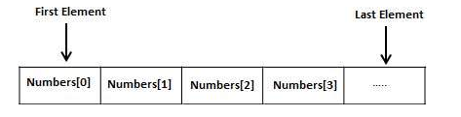
Arrays
An array stores a fixed-size sequential collection of elements of the same type.
An array is used to store collection of data.
Instead of declaring individual variables, such as number0, number1, …, and number 99, you declare one array variable such as numbers and use numbers[0], numbers[1] and …, numbers [99] to represent individual variables.

Slide 5
Programming with Arrays in C#
Arrays in C# are very similar to arrays in C.
They are defined by using the square brackets operator [ ].
They are initialized using a list defined with curly braces.
For example
int [ ] numbers = {1,2,3,4,5} ;
We can also define an empty array like this
int [ ] numbers = new int [10];

Slide 6
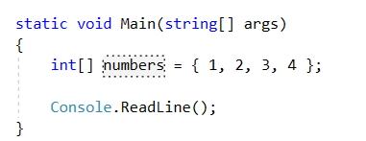
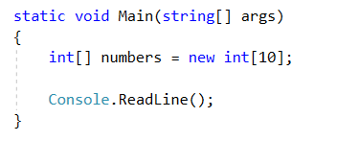
Programming with Arrays in C# Example

Slide 7
Multidimensional Arrays
C# allows multidimensional arrays
Multidimensional arrays also called rectangular array
Two Dimensional Arrays
The simplest form of the multidimensional array is the 2D array.
A 2D array can be thought of as a table, which has x number of rows and y number of columns.

Slide 8
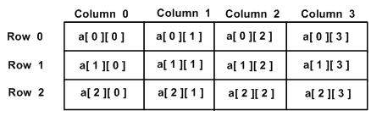
Two Dimensional Arrays
Following is a 2D array, which contain 3 rows and 4 columns.

Slide 9
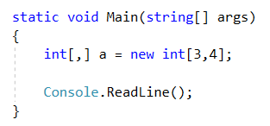
Two Dimensional Arrays
Following is a 2D array, which contain 3 rows and 4 columns.
Remember that you need to add a ‘comma’ (,) in between square brackets.

Slide 10
Task 01
Create a C# console application program.
Add a separate class called “TestArray” and inside the class add a method called “MyArray”. (No return type no parameter method).
Inside the “MyArray” method create a integer array size of 10 and get 10 user input numbers to the array. And print all the values inside the array.
Hint – Use a for loop.
Call “MyArray” method from main method which is inside program.cs

